Slide 1

CSYE 7374 Parallel Machine Learning & AI
Detecting Unknown Mining Pools and their Behaviour within Bitcoin using Parallelized Machine Learning
Presented By
Srinjoy Chakravarty
Srishti Ashok Mishra

Slide 2
INTRODUCTION
What is Blockchain?
A system in which blocks of cryptocurrency transactions are linked together through cryptographic hashes via a peer-to-peer network
Node — computing peer within the network
Transaction — immutable ledger record indicating a transfer of value
Block — data-structure used to batch transactions and relay them peer-to-peer
Chain — a sequence of blocks in chronological order
Cryptocurrency — algorithmic value token generated outside central bank or governmental purview
Miners — powerful nodes which create new monetary supply
Consensus — decentralized code-driven governance to validate all network activity

Slide 3
Definitions
Unknown Mining Pool Detection
Definitions¹ :
Pooled Mining: Pooled mining "pools" all of the resources of the clients in that pool to generate the solution to a given block. When the pool solves a block, the 6.25 BTC generated by that block's solution is split and distributed between the pools participants.
Solo Mining: Solo mining is when a miner performs the mining operations alone without joining a pool. All mined blocks are generated to the miner's credit.
Cause: Unknown Mining Pools are not necessarily one coordinated private pool. Rather, they could be a combination of solo miners and group miners that hide their pool
Motivation: Shadow mining may allow a group of miners to hide their hash rate or protect proprietary hardware (sub 5 nanometre ASIC chips)
Result: The lack of transparency poses a danger to the health of the bitcoin network as it may allow for game-theoretic attacks discussed later
¹ https://tinyurl.com/cfr632e

Slide 4
OBJECTIVE
Background: By analyzing the different characteristics of bitcoin transactions and identifying the behaviour of publicly-known Bitcoin pools in picking them to mine, we build a Machine Learning Classifier that is able to predict whether a transaction is mined by a mining pool or not
Motivation: Imagine if Nakamoto had moved one of his coins (he hasn’t moved his coins in years) and our classifier flagged it to have mined by an Unknown Mining Pool. Our deep-dive analysis would certain be useful.
Result: The confusion matrix from our predictive model allows us to use ‘False Positives’ to identify transactions that have been mined by a Shadow/ Dark mining pool
Reasoning: data points (transactions) where our model predicts mined_by_mining_pool == true, but in actuality have been labelled by the network as mined_by_mining_pool == false (WHY? LACK OF INFO??)
Objective: identify node addresses flagged to be ‘unknown’ by our prediction classifiers (false-positive) and do further data analytics (node centrality metrics etc.) to unravel malicious network activity

Slide 5
Dataset
Unlike other data, the blockchain never sleeps…
Since our dataset is huge and dynamic (changes every 10 minutes), we are indebted to the rigorous ETL framework₁ built by Google ¹ to utilize their specialty BigQuery service on live blockchain data.
The dataset we used ranged from a monster 1.0 to 1.3 GB!
This allowed us to get an incredible accuracy rates of 99.8395885589584% (Stacked Ensemble Classifiers) and 99.8375925642544% (Tensorflow Neural Net)
We used 26 unique features of a bitcoin transaction ranging from how much total monetary value the transaction contains to how long the inputs used in the sat idle before being included in the transaction!
¹ https://www.kaggle.com/wprice/bitcoin-mining-pool-classifier

Slide 6
Analysis Methodology
We use a combination of different Classification Algorithms and an Artificial Neural Network (ANN) to train our prediction models.
1. Serial Model 1 = Random Forest (SKLearn)
We check the accuracy of our classifier by plotting a Precision-Recall Curve and calculating the area under it
We use a Confusion Matrix to list out false positives and false negatives
These transactions are then further investigated with network analysis
2. Serial Model 2 = Gaussian Naive Bayes (SKLearn)
3. Serial AI Model = Artificial Neural Net (TensorFlow)
4. Parallelized ML Model = Multi-Node Stacked Classifier over Distributed Memory
(using Open-source MPI)

Slide 7
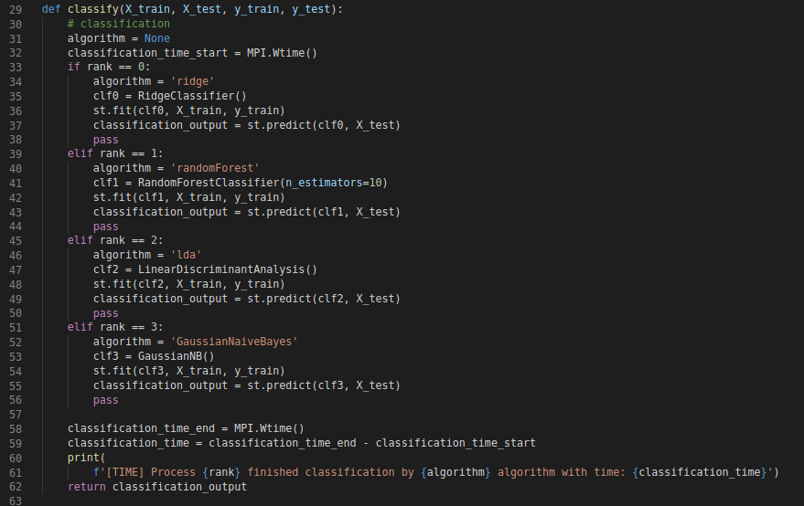
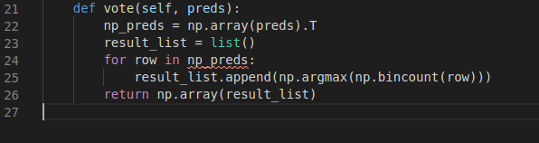
Optimization Techniques Used
To achieve maximum accuracy we use a Stacking technique where we split into 4 MPI Processes where each process runs a ML classifier (layer1) on our given dataset. Each process then fits the test data and returns its predictions back the the Master MPI Process.
The master MPI process receives each of the 4 predictions and puts them through voting mechanism to come up with predictions for every row (x-test) of transaction data by using a majority vote is used to determine y-pred (layer2)

Slide 8
ANALYSIS
Model storage, joblib vs pickle vs parquet
For 1.2 gigabytes of Bitcoin Transaction Data
*HDF5 has superior Read/Write speeds than both Parquet and Feather but begins to fail
once the dataset grows too large
Big Data Storage Comparison (1.2 GB Bitcoin Transaction Data) | Write to disk | Read to disk | Filesize (mb)
Parquet (multi-threaded) | 49.5127 | 70.133 | 725.7
Feather (multi-threaded) | 56.2501 | 78.925 | 823.6
Pickle | 49.813 | 13.8363 | 2100
HDF5* | Fails | Fails | Unfair to compare

Slide 9
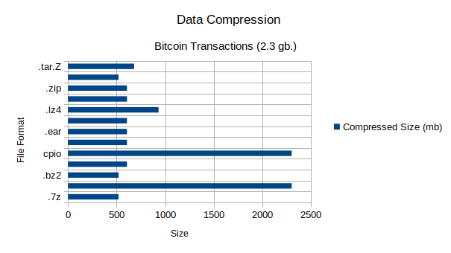
Dataset Compression (Post - ETL)
We tried 27 different data compression techniques to minimize the size of our dataset (1.3+ GB ) and reduce network latency when passing data between local workstations, servers and high-performance cluster nodes. The file format with the Highest Compression Ratio was .7zip with Space Saving Score of 78.35%
Space Saving = (Compressed Size) / (Uncompressed Size)
0.7835 = 1 - 519.3 / 2,982.4

Slide 10
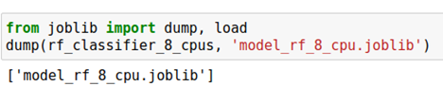
Saving the Model so you can Throw Away the Data (Pickle vs JobLib)
The idea behind any Data Science is to be able to build a model and throw away all the data.
We compared data write speeds of both Pickle vs JobLib (the palatalization library) behind sci-kit learning (written in Cython) and found that joblib was usually significantly faster on large numpy arrays because it has a special handling for the array buffers of the numpy data structure.

Slide 11
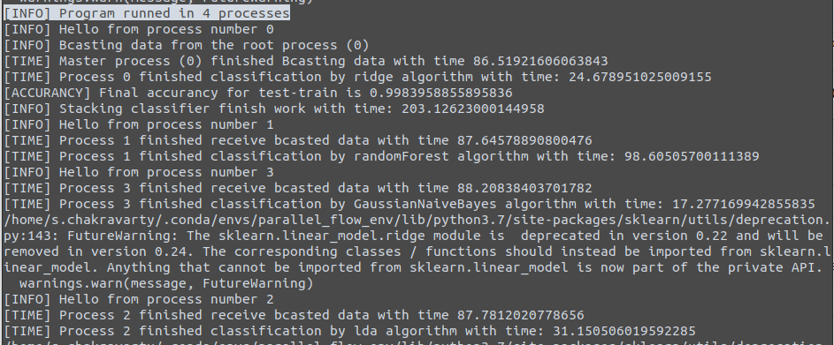
Model Training Parallelization
Hardware Setup (4-node CPU cluster each with 180 GB RAM)
> $ srun -p short --cpus-per-task 4 --ntasks 4 --nodes 4 --pty --export=ALL --mem=180Gb --time=08:00:00 /bin/bash
We created a virtual anaconda environment to install our custom software
> $
We used MPI for Python to interface with HPC shared nodes
> $ conda install -c anaconda mpi4py
We used OpenMP version 3.1.2
> $ module load openmpi/3.1.2

Slide 12
Performance Gains in Model Training gained with Distributed Memory Parallelization
How Stacked Classifier Works
Each process trains on the datasets and builds a model
Each process then provides a probabilistic prediction with .fit()
Vote Function¹
The Master Process then takes a vote on which model to use for prediction (binary 0 or 1)
Improvements
Bin count gives you the ratio of which model voted for which outcome [0 | 4], [1 | 3], [2 | 2], [3 | 1], [0 |4]
Unfortunately, since its an even number of models argmax() defaults to the first occurrence i.e. False
In this case we can take 2 approaches
Numpy argmax - random tie breaking
Odd number of Classifiers (5 MPI Processes)
¹ https://github.com/codevibess/parallel-stacking-classifier

Slide 13
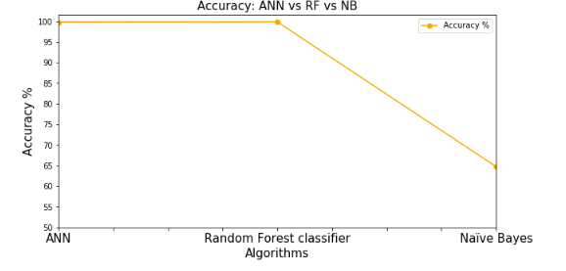
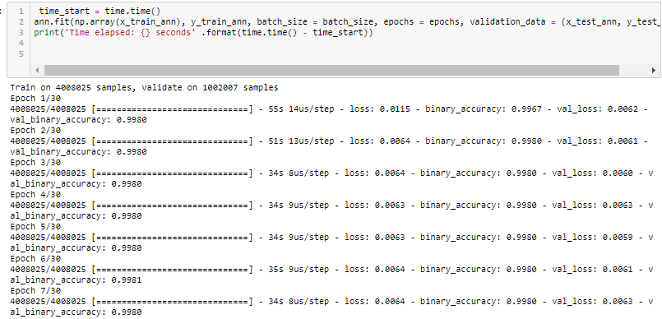
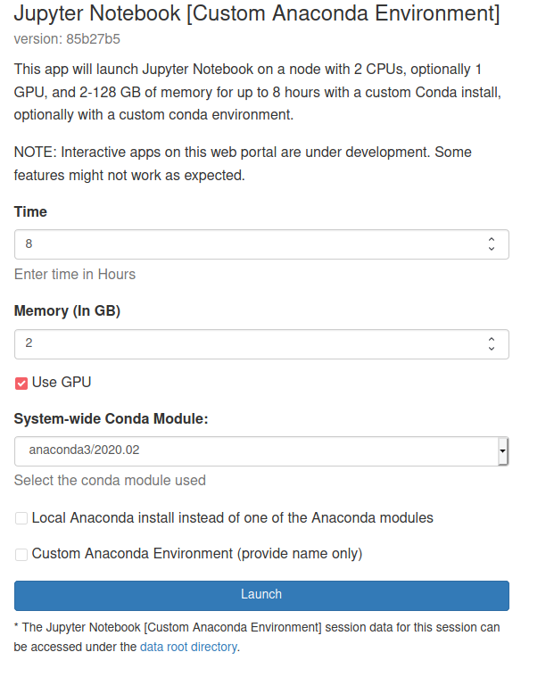
ML Model Accuracy Comparison
When the accuracy is compared, we see that our Random Forest Classifier performs the best with our data (as long as we use around 100 trees) while our Artificial Neural Net only reaches the same level of accuracy when we use a high number of Epochs! The high number of Epochs means the entire training of duration including multiple rounds back propagation takes a much longer time!
We tried to use a GPU setup via OpenOnDemand (OOD) on HPC to speed up our Notebook and found some reduction in training times.

Slide 14
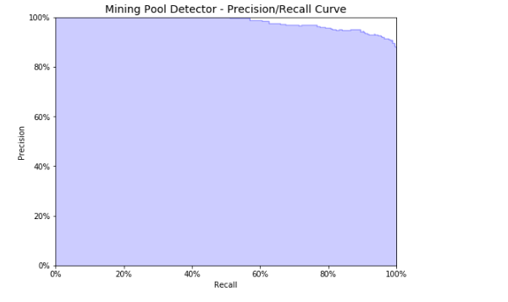
Prediction Accuracy Curve
An ideal system with high precision and high recall will return many results, with all results labeled correctly
Our curve when applied on a heavily trained model should great Precision even at the highest end of the Recall spectrum.

Slide 15
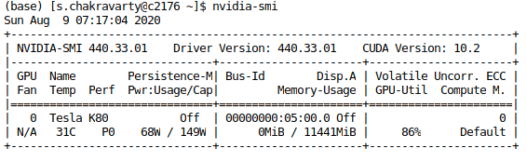
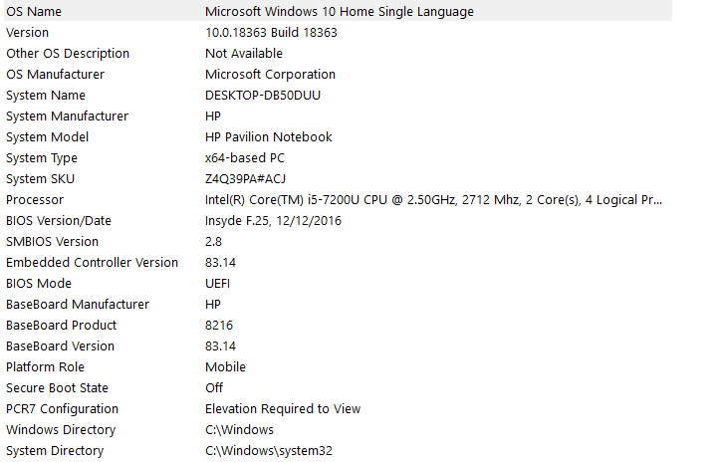
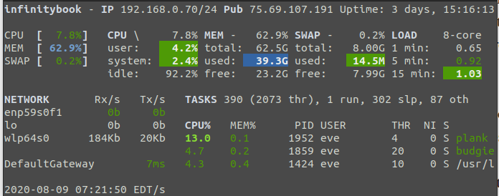
Artificial Neural Network Speed Analysis
HPC Nvidia GPU (Open OnDemand on Discovery) Dual-core CPU
Octa-core i7 10th gen CPU

Slide 16
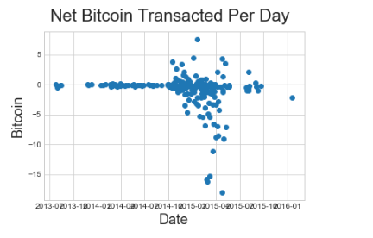
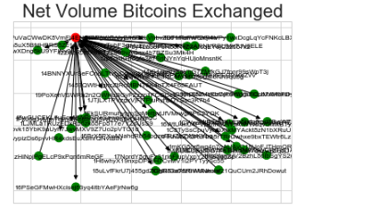
Network Analysis on a chosen Unknown Bitcoin Node
We decided to investigate our chosen unknown node address: 1PuVaCWwDK8VmFj4EN8e2EgxvDpjeyJmRx
Exploratory Data Analysis
Unique addresses that were included in the transaction history of our chosen Node wallet
Top addresses that our Unknown Node wallet interacted with
Transaction activity of our chosen Unknown Node across time
Node centrality analysis of the wallet address our node sent most Bitcoins to

Slide 17
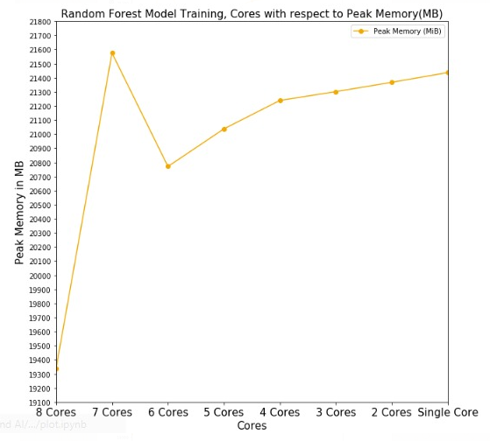
Memory Profiling
We analysed how increasing the number of CPU cores allow us reduce the peak memory usage when training our machine learning models on huge datasets.
Here is an example of Peak Memory over multiple cores when using a Random Forest Training Algorithm

Slide 18
Future Optimization Plan
Use SKompiler¹ to transform trained SKLearn models into symbolic python (Sympy) expressions which, in turn, can be translated to C++, Javascript, Rust and Julia code. Benchmark model training speed of each language.
Transpile² trained scikit-learn models to C, PHP, Java and Ruby code. Benchmark model training speed of each language.
Prediction: Julia code may have the highest model training performance.
¹ konstantint/SKompiler: A tool for compiling trained SKLearn models into other representations (such as SQL, Sympy or Excel formulas)
² nok/sklearn-porter: Transpile trained scikit-learn estimators to C, Java, JavaScript and others.

